Slide 1
PyTorch Distributed and Parallel Training - 2
20230412
박현우

Slide 2
Table of Contents
What is FSDP
How FSDP operates
How to use FSDP

Slide 3
What is FSDP
Remind DDP
What is FSDP
Superiority of FSDP over other parallelisms

Slide 4
1.1 Remind DDP
In DistributedDataParallel, (DDP) training, each process/ worker
owns a replica of the (complete) model
and processes own batch of data,
finally it uses all-reduce to sum up gradients over different workers.
In DDP, these are replicated across all workers:
the model weights
and optimizer states

Slide 5
1.2 What is FSDP
Fully Sharded Data Parallel FSDP is Data and Model parallel training algorithm.
FSDP shards across ranks:
model parameters
optimizer states
and gradients
This is called Full Parameter Sharding.
Thus, FSDP can be regarded as Inter-layer Parallelism or Pipeline Parallelism.

Slide 6

1.2 What is FSDP
Suppose a model :
Optimizer State : Gradients through backward pass of complete model. i.e. Backward pass through all l_1, l_2, l_3 (= F(x)).
Gradient : Gradient through both forward and backward pass of specific subset of the model (here, layers). e.g.
Forward pass through only l_1.
Backward pass through l_2 (given Gradient of l_3)
i.e. Optimizer State = all backward Gradients

Slide 7
1.2 What is FSDP
Another core aspect of FSDP is that although the parameters are sharded to different devices (GPUs),
FSDP makes the computation for each microbatch of data still local to each GPU worker.
= Minimize amount of communications while having Full Parameter Sharding across the cluster.

Slide 8
1.2 What is FSDP
Although minimized, FSDP has still larger communication volume compared to only data-parallelisms, caused by Gradient Synchronization.
Such increased communication overhead is reduced by internal optimizations of FSDP;
i.e.
Decomposing Communication and Computation
and Overlapping them during training.

Slide 9
1.3 Superiority of FSDP over other parallelism
FSDP Device Local memory footprint would be smaller than that of DDP across all workers;
as FSDP workers only contains shards of the model, not the whole replica.
Gains of FSDP:
This makes the training feasible of some very large models
and helps to fit larger batch sizes for our training job.

Slide 10
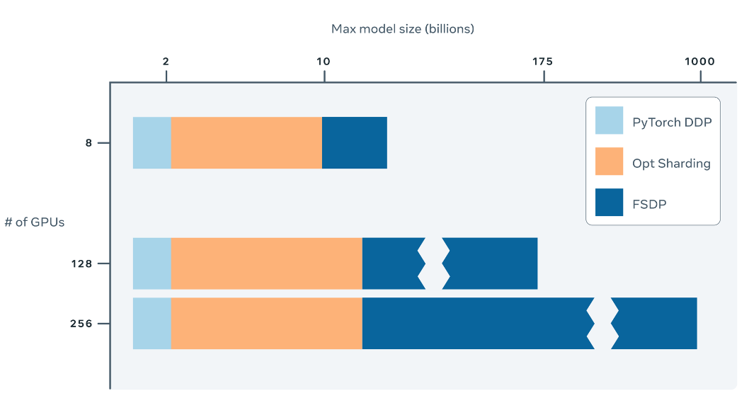
1.3 Superiority of FSDP over other parallelism

Slide 11
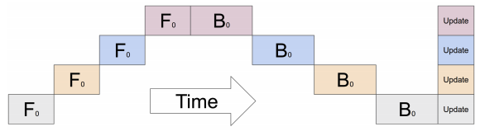
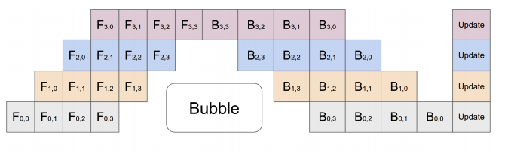
1.3 Superiority of FSDP over other parallelism
Even with Full Parameter Sharding, FSDP makes computation local on each device.
This conceptual simplicity makes FSDP
easier to understand
and more applicable to a wide range of usage scenarios.
(compared to
intra-layer parallelism
and pipeline parallelism
which are typically model-specific).

Slide 12
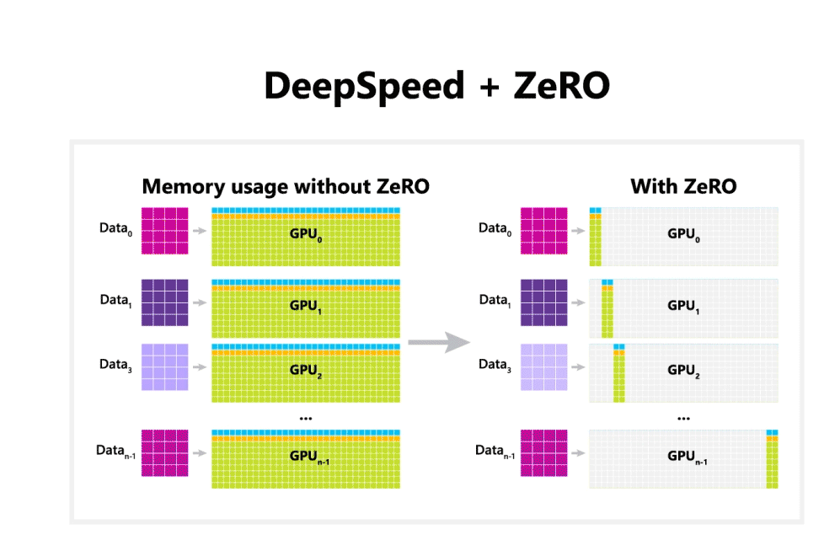
1.3 Superiority of FSDP over other parallelism
Such Full Parameter Sharding of FSDP is compatible with many other strategies.
Thus, FSDP can be easily integrated with other algorithms.
e.g. ZeRO-3 (ZeRO-Infinity) of DeepSpeed.
i.e. Parallelized optimizer for model and data parallelism

Slide 13
1.3 Superiority of FSDP over other parallelism
As well as main FSDP parallelism, FSDP also supports CPU offload for parameters and gradient.
e.g. Zero-Offload series of DeepSpeed
This makes possible to train even larger model.
(However, due to frequent copying of tensors from host to device
this feature may slow down the training considerably.)

Slide 14
2. How FSDP operates
Decomposition of All-Reduce
Structure of FSDP
Procedure of FSDP
Comparison to DDP
Full Architecture of FSDP

Slide 15
2.1. Decomposition of All-Reduce
In standard DDP training,
every worker processes own separate batch
and the gradients are summed (sync-ed) across workers using an all-reduce operation.
The key insight to unlock full parameter sharding is that we can decompose the all-reduce operations in DDP into separate operations:
reduce-scatter
and all-gather

Slide 16
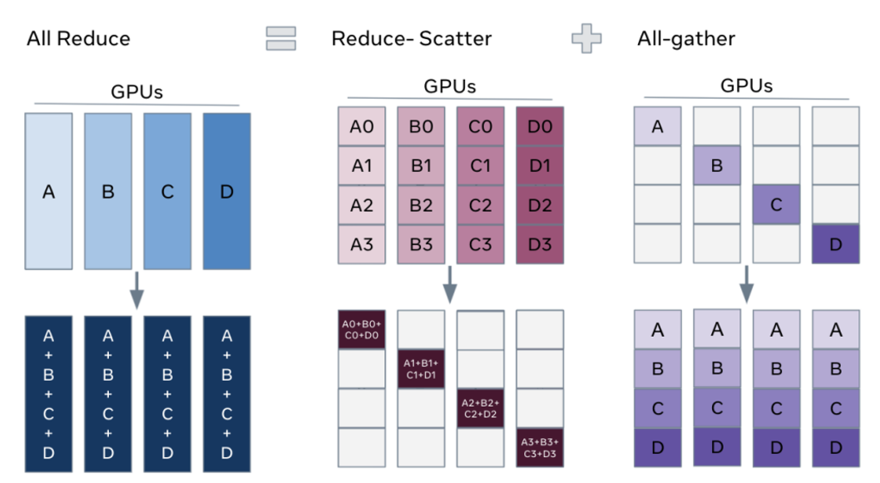
2.1. Decomposition of All-Reduce

Slide 17
2.1. Decomposition of All-Reduce
In standard DDP,
Optimizer states with respect to each batches are sync-ed across all devices via All-Reduce.
In FSDP, such Optimizer states are decomposed into multiple Gradients.

Slide 18
2.1. Decomposition of All-Reduce
During the reduce-scatter phase,
the gradients are aggregated in equal blocks among ranks based on their rank index.

Slide 19
2.1. Decomposition of All-Reduce
During the all-gather phase, the sharded portion of aggregated gradients on each GPU are propagated to all GPUs.

Slide 20
2.1. Decomposition of All-Reduce
Once All-Reduce decomposed into multiple Reduce-Scatter + All-Gather,
we can then rearrange them
so that each worker stores only a single shard of
parameters
and optimizer states (= Gradients).

Slide 21
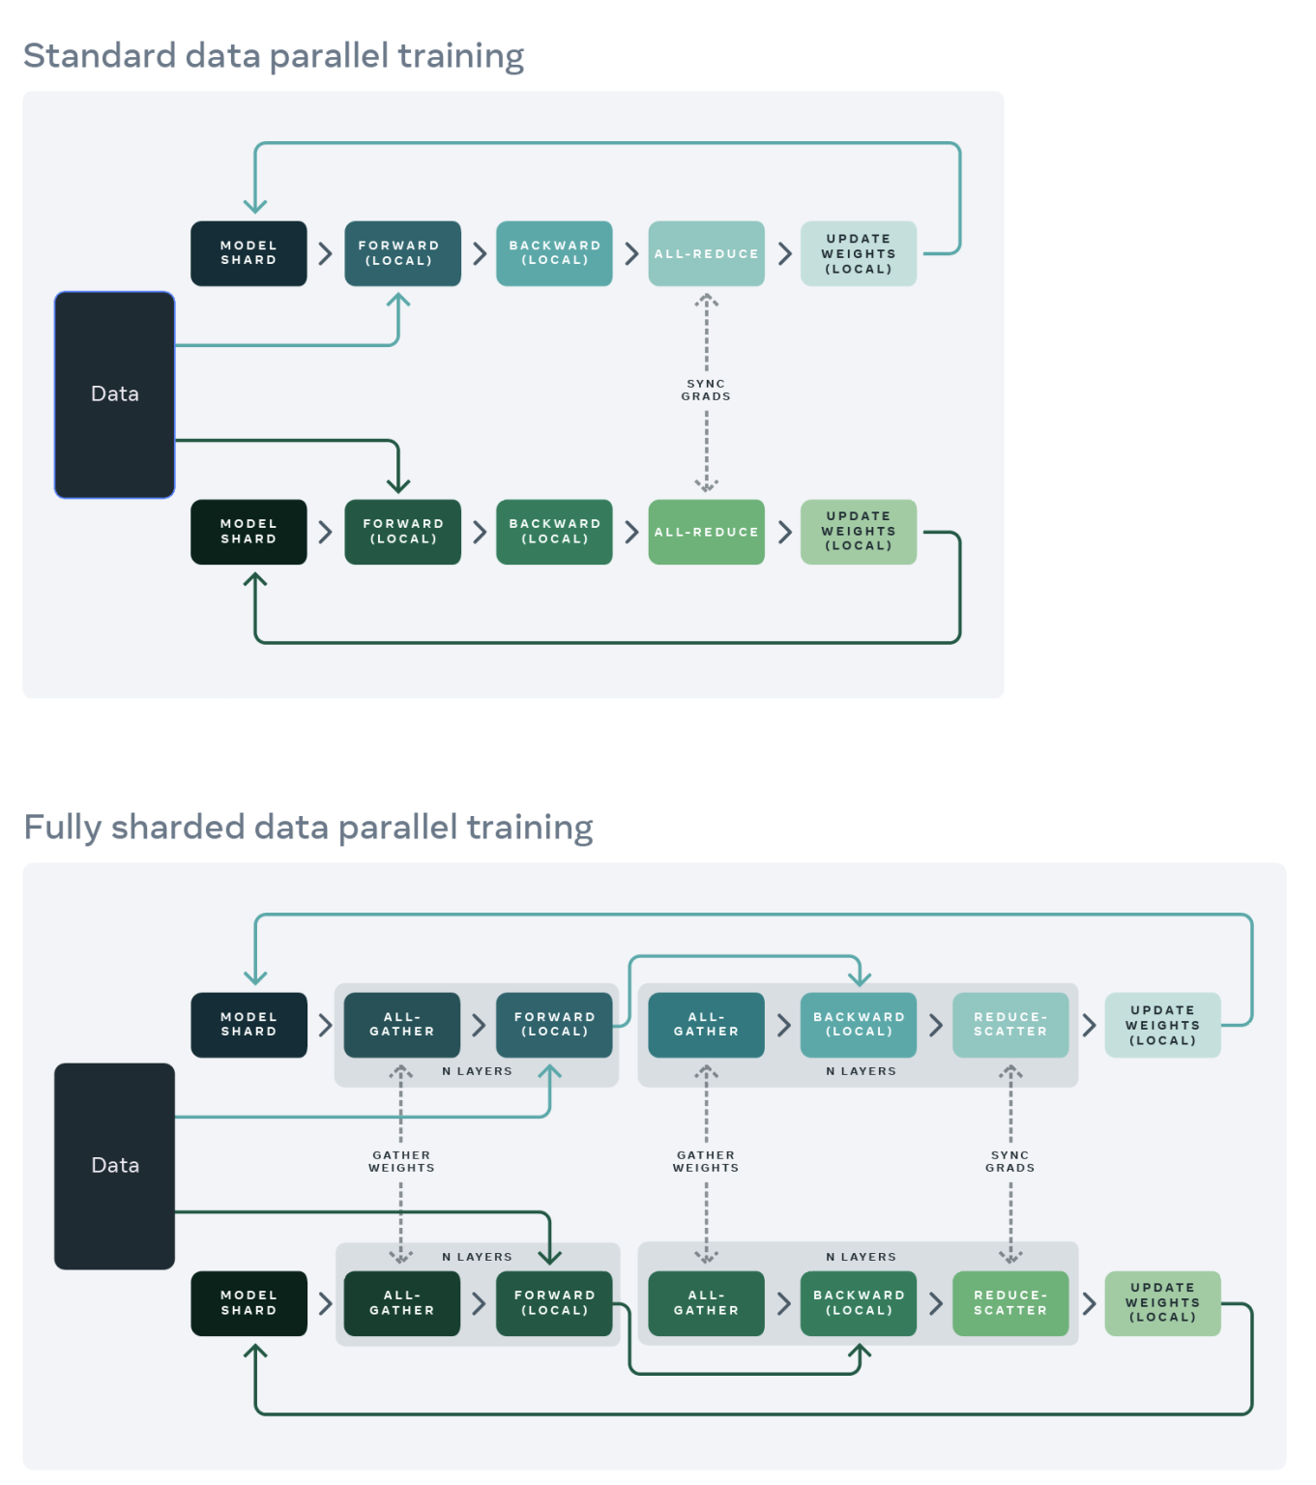
2.2. Structure of FSDP

Slide 22
2.2. Structure of FSDP
In FSDP, only a shard of the model is present on a GPU. i.e. In this figure, N layers of the model.
c.f. Full model is replicated across all GPU in DDP.
Then, in order to compute full forward/backward pass, all weights are gathered from the other GPUs by means of an all-gather step.

Slide 23
2.3. Steps of FSDP
Assume :
There are 2 Machines with 1 GPU each
First N Layers are in Rank 0, remain N layers are in Rank 1. i.e. FSDP instance 1:N layers
Dataset is sharded for each machine. (Dataset 0 and Dataset 1)

Slide 24
2.3.1. Forward Pass
For Layer_1, (in Rank 0)
Rank 1 calls All-Gather for Layer_1, as Rank 1 doesn’t have it. (Rank 0 can skip this, as Rank 0 holds it on itself. )
Both Rank 0 and 1 computes for Layer_1 on their own dataset.
(... for all layers)

Slide 25
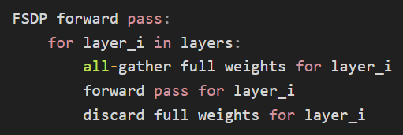
2.3.1. Forward Pass
To maximize memory efficiency,
discard full weights for each layer after that layer’s forward pass.

Slide 26
2.3.1. Forward Pass
At the end of forward pass,
each device contains outputs of full model with respect to their own dataset.

Slide 27
2.3.2. Backward Pass
Computation of backward pass is the same as forward pass.
Only difference is that after each backward pass (i.e. for each layer),
the local gradients are sync-ed (= averaged) across the GPUs
by means of a reduce-scatter step

Slide 28
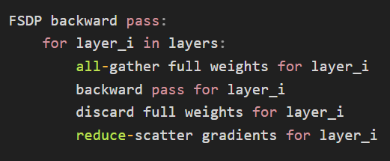
2.3.2. Backward Pass

Slide 29
2.3.3. Update
Given reduced gradients from other devices,
each device updates its local weight.

Slide 30
2.4. Comparison to DDP

Slide 31
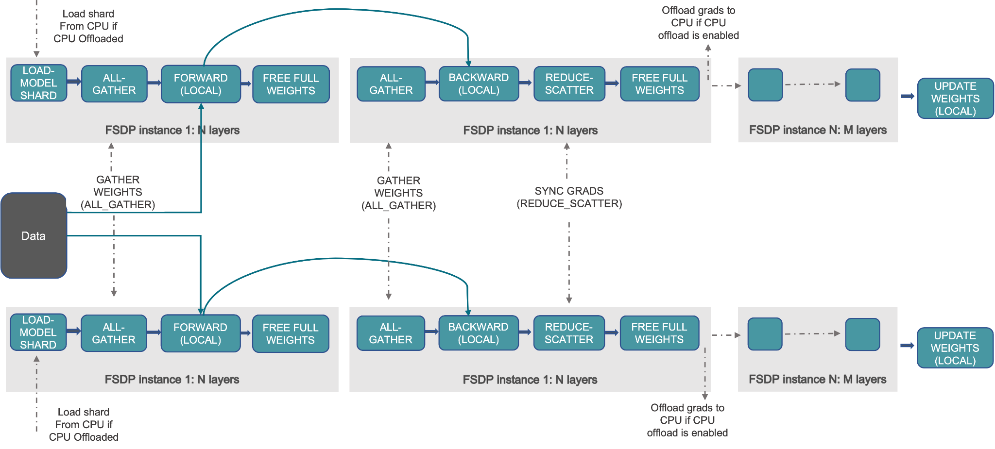
2.4. Full Architecture of FSDP

Slide 32
2.4. Full Architecture of FSDP
Although previous example has 1:N layers per FSDP instance,
FSDP can also map N:M layers.
In this case, some instances contain redundant layers, (= waste of memory) but are cooperating in communication (= share load across instances).

Slide 33
2.4. Full Architecture of FSDP
FSDP also supports CPU-offload (Zero-Offload)
for cases where even sharded parameters are too large to fit in each devices.

Slide 34
3. How to use FSDP
FSDP produces identical results as standard distributed data parallel (DDP) training
and is available in an easy-to-use interface that’s a drop-in replacement for PyTorch’s DistributedDataParallel module.

Slide 35
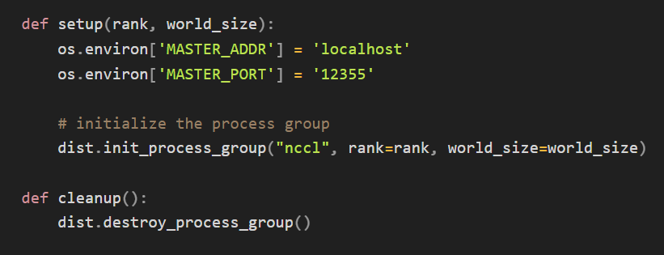
3. How to use FSDP
Helper functions
to initialize the processes for distributed training
and clean up.

Slide 36
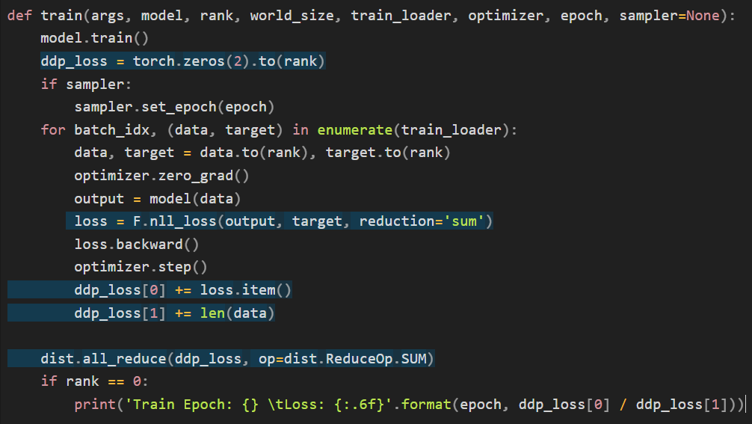
3. How to use FSDP
Function for training is almost the same as normal PyTorch,
except: loss is packaged and distributed via All-Reduce.
(FSDP internally decomposes and re-schedules All-Reduce)

Slide 37
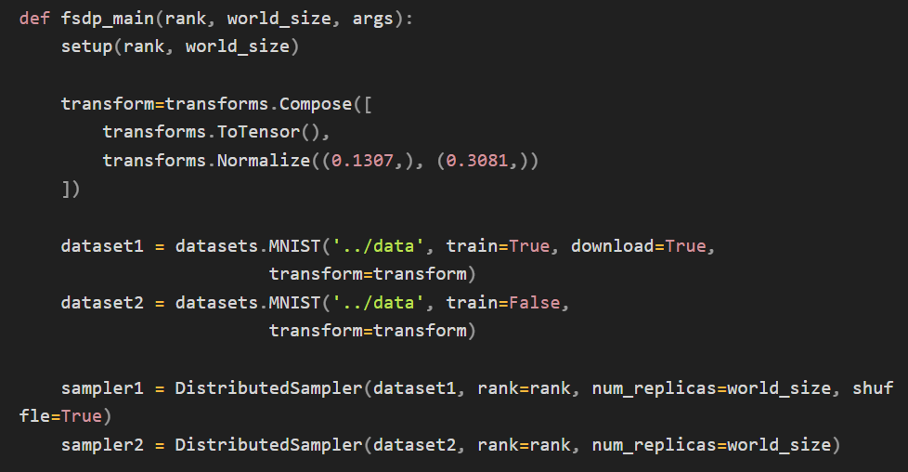
3. How to use FSDP
transformers is TorchVision Transformer model.
DistributedSapmler uniformly distributes data across all processes.

Slide 38
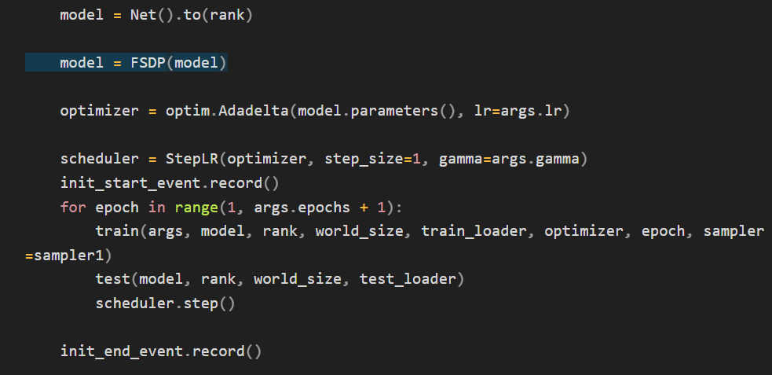
3. How to use FSDP
Once wrapped the model with FSDP,
now model can start training simply.

